Slide 1

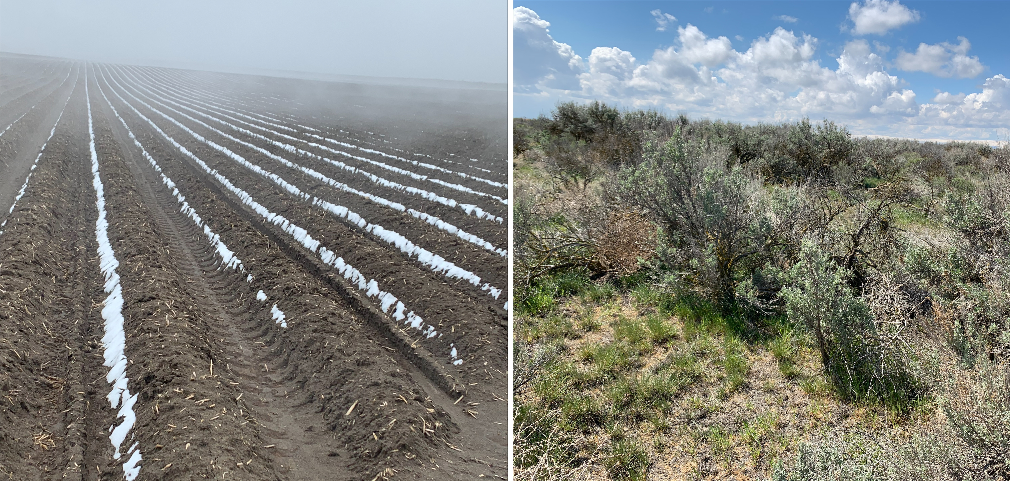
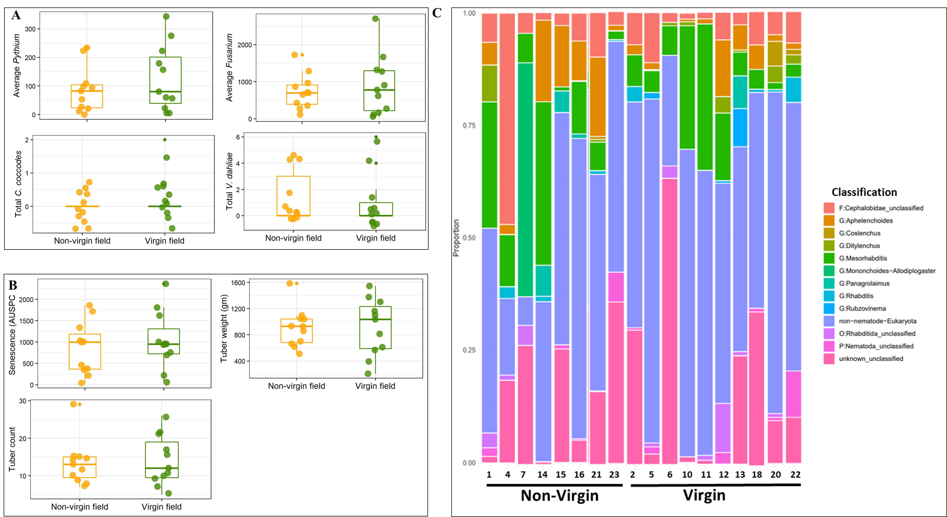
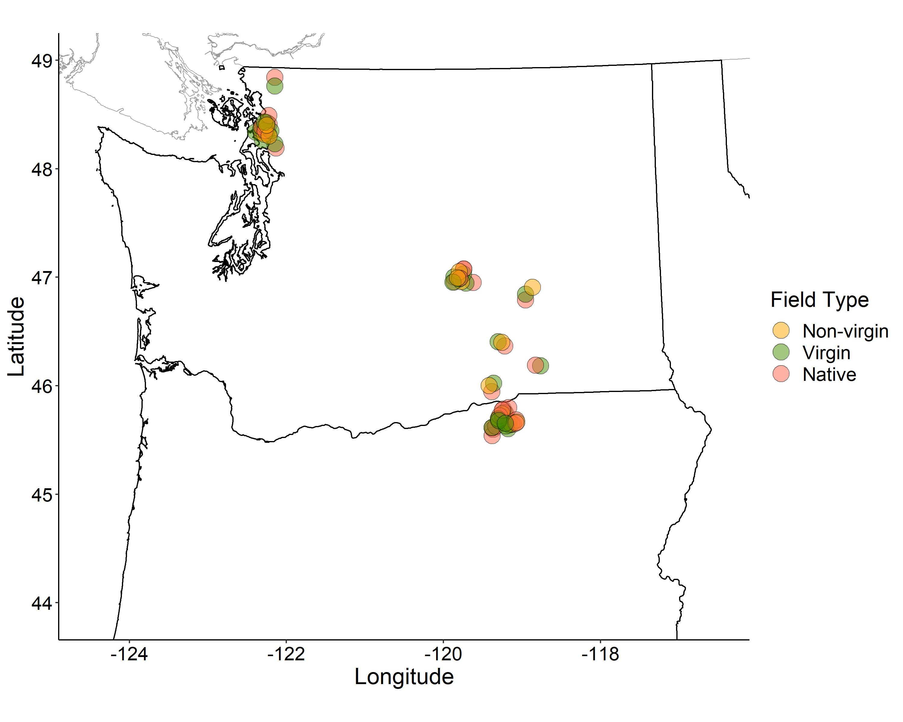
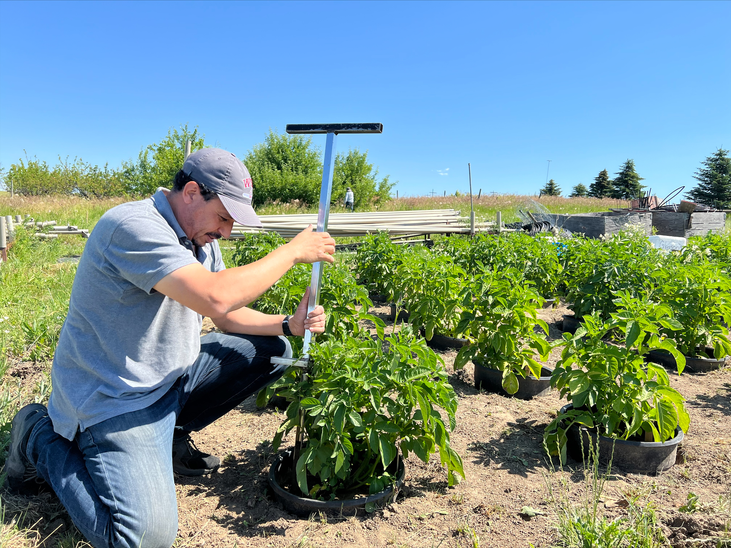
Identifying the soil microbiome associated with potatoes in virgin, non-virgin and native soils
Sudha GC Upadhaya¹, Jessica Franco¹, Cynthia Gleason¹, Deirdre Griffin LaHue¹, Kenneth Frost², David Linnard Wheeler³, and Timothy C. Paulitz⁴
¹Washington State University, WA, ²Oregon State University, OR, ³University of California, Berkeley, CA ,⁴United States Department of Agriculture –ARS, WA
Motivation
Workflow
Soil microbial organisms play important role in biogeochemical cycling and contribute towards soil and crop health. However, human intervention of native lands for agricultural use alter the microbial composition of soil (Rodrigues et al. 2013).
Potato growers in the Pacific Northwest (PNW) region have observed yield benefit of up to 26% in the fields that were never into agriculture or potato cultivation (virgin soils) compared to the nearby fields with the history of potato cultivation (non-virgin soils) (Communication with growers).
Most studies conducted in potato microbiome are limited to agricultural soil (Berendsen et al. 2012). We have limited understanding on what soil factors drive higher yield in virgin/native soils and how differently potato recruits the microbiome from agricultural versus natural soils.
Therefore, investigation of the microbiota present in bulk soil, potato rhizosphere, root, and tuber in soils from various ecosystem will fill gaps in our current understanding of the potato microbiome.
Figure 4: Workflow of the project
sd
Results
Figure 1: Agricultural land with the history of potato cultivation (a) and nearby native land (b) in the Columbia Basin.
Major soil borne pathogens detected in both virgin and non-virgin fields (Figure 5A).
No significant yield difference observed between virgin and non-virgin fields (Figure 5B).
Free living nematode genera and plant parasitic nematode genera, Ditylenchus found in both field types (Figure 5C).
Soil physical, chemical, and additional biological properties are forthcoming.
Rhizosphere, root and tuber samples are being collected and processed.
Objectives
Study bacterial, fungal, nematode and soil borne pathogen abundance and diversity in bulk virgin, non-virgin and native soils collected from Columbia and Skagit Valley of Pacific Northwest.
Quantify potato performance in the microplots
Study bacterial and fungal microbiome recruitment in rhizosphere, roots, and tuber by potato planted in virgin, non-virgin and native soils.
F
Study Design
Soil sample collection (Figure 2):
Total no. of sampling sites = 76
Virgin fields = 30
Non-virgin fields = 30
Native sites = 16
Bulk soil characterization:
Biological properties
Amplicon sequencing of bacteria (16S rRNA), fungi (ITS1) and nematodes (18S rDNA)
Quantification of soil-borne pathogens of potato using soil plating method
Physical and chemical analyses
Figure 5: Abundance of soil-borne pathogens including Pythium spp, Fusarium spp, Verticillium dahliae, and Colletotrichum coccodes in the bulk soil collected from virgin and non-virgin fields in 2021 (A). Potato performance in microplots (B). Nematode classification in bulk soil at various taxonomic levels : phylum (P), order (O), family (F), or genus (G) in non-virgin and virgin fields (C).
Expected Outcomes
Quantify potato performance in microplots:
Establish microplot in Pullman, WA
Record potato senescence, tuber count and yield data
This multi-year project aims to characterize the soil biotic community and potato microbiome in both natural, and agricultural soils.
The project will contribute towards defining core potato microbiome.
The results obtained from this project will contribute towards establishing the soil health indicators for potato production in the Pacific Northwest region.
Figure 2: Soil sampling locations in WA and OR in 2021 and 2022.
Microbiome characterization in potato rhizosphere, root and tuber:
Rhizosphere and endosphere samples from 2-month-old potatoes (Figure 3)
Tuber
Amplicon sequencing for bacterial and fungal communities
References and Acknowledgement
Berendsen, R.L., Pieterse, C.M. and Bakker, P.A. 2012. The rhizosphere microbiome and plant health. Trends Plant Sci. 17:478-486.
Rodrigues, J.L., Pellizari, V.H., Mueller, R., Baek, K., Jesus, E.D.C., Paula, F.S., Mirza, B., Hamaoui Jr, G.S., Tsai, S.M., Feigl, B. and Tiedje, J.M. 2013. Conversion of the Amazon rainforest to agriculture results in biotic homogenization of soil bacterial communities. PNAS. 110:988-993.
We thank the Northwest Potato Research Consortium for funding this project.
Learn from data
Figure 3: Sample collection from potato rhizosphere in the microplots

